Slide 1
Object-oriented Design Patterns:
Quick Reference Guide

Slide 2
Preface
This is a “living” document that will be refined and extended throughout the semester.
Please feel free to make suggestions
Much of the material in this documents come from “Design Patterns:
Elements of Reusable Object-oriented Software”, by Eric Gamma, et al.
Last updated 10/17/2016

Slide 3
Strategy Pattern
Intent: Allow algorithms to be selected at runtime, by defining a family of algorithms, encapsulating each algorithm, and making the algorithms interchangeable within that family
Context: Implementation of a family of algorithms
Problem: This pattern addresses situations where there are multiple ways of doing the same kind of thing, but with different kinds of input, output, or runtime characteristics and the choice of which way to do it has to be made at runtime

Slide 4
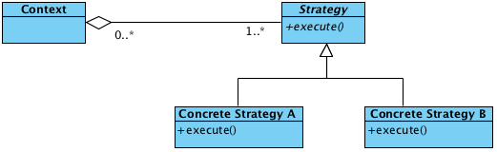
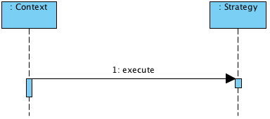
Strategy Pattern
Solution: The solution is to extract the behavior from the main class that uses them (i.e., the context) and encapsulation them in a hierarchy of strategy classes. At runtime, create instances of the concrete strategy classes and associate them instances of the context.

Slide 5
Strategy Pattern
Consequences:
In the strategy hierarchy, inheritance can help factor out common functionality of the algorithms, especially if combined with the Template Method pattern.
Encapsulating the algorithm in separate Strategy classes lets you vary the algorithm independently of its context, making it easier to switch, understand, and extend.
Strategies can eliminate conditional statements.
Aliases: Policy Pattern
Related Patterns:

Slide 6
Observer Pattern
Intent: Simplify dependencies between objects when state changes are a primary concern.
Context: There are multiple possible contexts, but the most common is graphical user interfaces, where multiple displays need to show state information about the same objects. However, in general, the context could be any system where state changes need to be monitored by multiple components.
Problem: The system includes a objects of certain classes (i.e., subjects) whose state changes must known by objects of other classes (i.e., observers). The subjects and the observers may be organized into sub-classes.

Slide 7
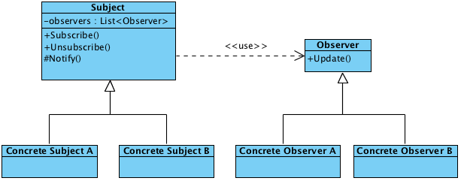
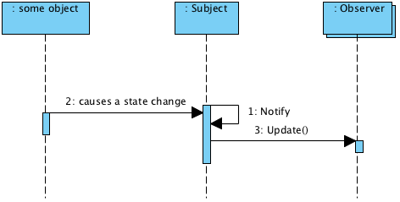
Observer Pattern
Solution: The solution involves encapsulating the state-change tracking behavior inside an Observer class or class hierarchy and the managing and notification of the observers inside a Subject class or class hierarchy.

Slide 8
Observer Pattern
Solution: The base subject class includes methods for subscribing and unsubscribing observers. However, the pattern does not prescribe which component(s) of a system use these methods to attach or detach observers to subjects.
The base observer class defines an interface for updating. Subjects only have to depend on this interface and do not need know any other details of the base observer or its subclasses

Slide 9
Observer Pattern
Solution: The concrete subject classes define mechanism for the subject objects to store state information that is of interest to the concrete observers.
Concrete observer classes implement the update interface defined by the base observer class and typically define mechanisms for the observer objects to manage references to the subject(s) they are observing. These references are type cast as concrete subjects by the variables that hold them so the concrete observers can access concrete subject’s state information. The concrete observers may also redundantly store some of the concrete subjects’ state information for improved performance.

Slide 10
Observer Pattern
Consequences:
Lower coupling between subjects and observers
Support a multicast-style of communication, where the sender (subject) does not need to know about or depend on the specific receivers (concrete observers)
Observers can be completely independent of each other, even though they may deal with the same subject object
Aliases: Publish-Subscribe
Related Patterns: MVC, MVVC

Slide 11
Decorator Pattern
Intent: Attach any combination of additional responsibilities to an object at run time
Context: Any system where combinations of features are possible and there is a potential for an explosion in the number of sub classes
Problem: The actors of a system need to add or remove features to an object dynamically

Slide 12
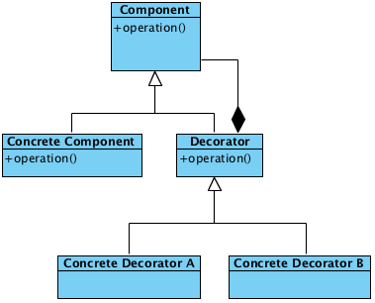
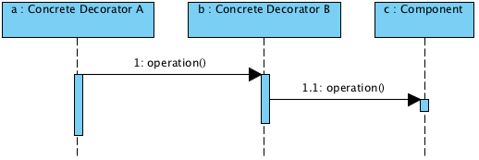
Decorator Pattern
Solution: Define specializations of the component to which features will be added that encapsulate those features. At run-time create an chain of objects that represent the enhance object. The last object in the chain is the original object and object preceding it are the add-on features

Slide 13
Decorator Pattern
Solution: The base component class defines the interface for all objects of that type, including the add-on features.
The concrete components define whatever details are necessary to implement specific types of components. If there are no specific types of components, this class can be rolled up into the base component.
The base decorator class maintains a reference to the component it decorates. It delegates certain behaviors to this object.
A concrete decorator implements an add-on feature.

Slide 14
Decorator Pattern
Consequences:
More flexibility that static inheritance
Avoid explosion of sub-classes
More testable than one bloated class
Lots of little objects linked in a delegation chain that represent one real-world object
As the components interface becomes more complex, the complexity of the decorator also increases
Aliases: Wrapper
Related Patterns: Chain of Responsibility

Slide 15
Simply Factory Idiom
Intent: Reduce coupling with concrete constructors
Context: Any situation where a system needs to create instances from a hierarchy of classes
Problem: A component needs to create a specific kind of object from a class hierarchy, called the product class hierarchy, but the choice of which concrete product subclass to instantiate has to be made at runtime.

Slide 16
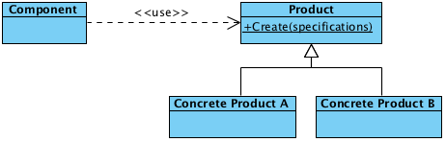
Simple Factory Idiom
Solution: Define a static method (i.e., one associate the base class of the product class hierarchy) that encapsulates the logic for constructing the right kind of specialization.

Slide 17
Simple Factory Idiom
Consequences:
The component that needs to create a product object doesn’t need to know about the individual constructors for the concrete product classes.
Aliases: Factory
Related Patterns: Factory Method, Abstract Factory

Slide 18
Factory Method Pattern
Intent: Reduce coupling in relation to the creation objects by implementing “virtual constructors” called factory methods.
Context: In development of a class library or framework (not just a single system)
Problem: A class library or framework needs to allow for the dynamic construction of objects from a product class hierarchy and needs to allow customization of the construction process from application to application

Slide 19
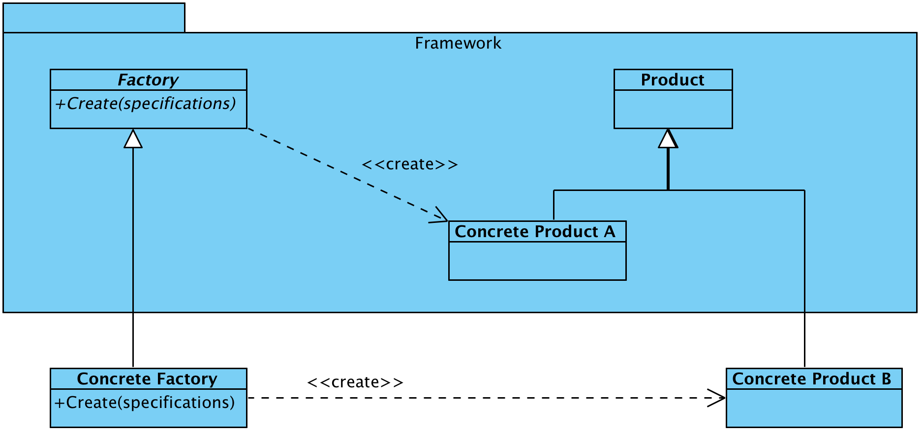
Factory Method Pattern
Solution: Define a base product class and base factory class in the framework. Allow applications to specialize both as needed. Application should program to the Create method interface.

Slide 20
Factory Method Pattern
Consequences:
Eliminates the need to bind application-specific classes into a framework
Creating objects inside the factory method is flexible than creating an object directory.
The create method (the factory method) gives subclasses a hook for providing an extended version of an object
Applications must special the base factory class, as well as the product base classes
Aliases: Virtual Constructor
Related Patterns: Simple Factory Idiom, Abstract Factory

Slide 21
Abstract Factory Pattern
Intent: Provide an interface creating objects (products for families of parallel class hierarchies.
Context: The development of a cross-platform class library or framework
Problem: A class library or framework needs to allow for the dynamic construction of objects from a product class hierarchy, but that hierarchy needs to be implemented in multiple way or on multiple platforms

Slide 22
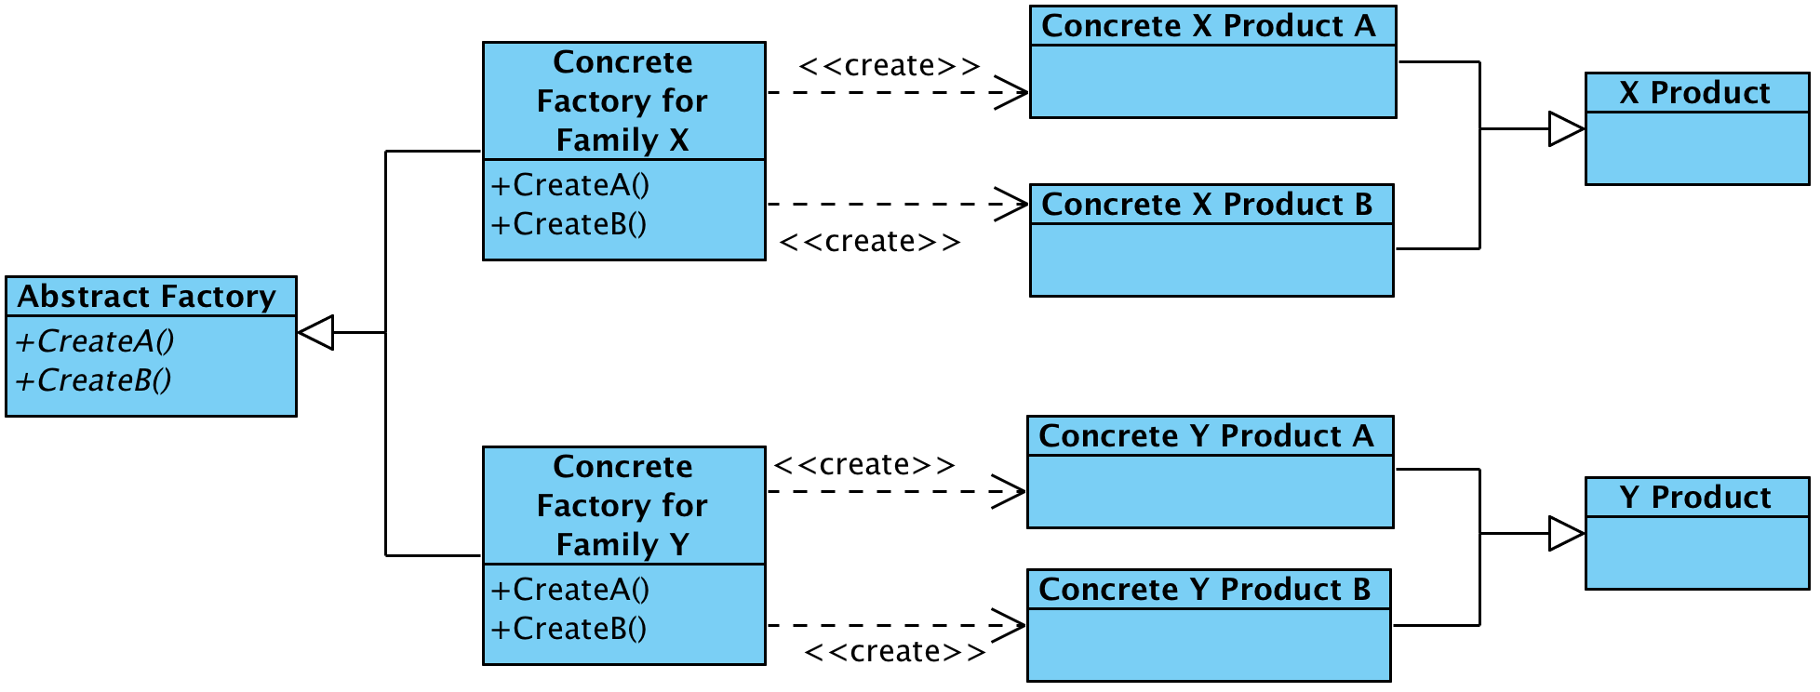
Abstract Factory Pattern
Solution: Each product family is implemented in its own hierarchy. A base abstract factory defines an interface for create each type product. There is concrete factory that implements that interface for each family of products.

Slide 23
Abstract Factory Pattern
Consequences:
It isolate concrete classes
It makes exchanging product families easy
It promotes consistency among products (and requires consistency among the product class hierarchies)
Adding new kinds of products is difficult
Aliases: Kit
Related Patterns: Factory Method

Slide 24
Singleton Pattern
Intent: Ensure that a class only has one instance and provides a global point of access to it.
Context: Any software system
Problem: The software system includes a class that truly has only one instance from either the problem- domain or solution-domain perspective, and many other components in the system need to access that instance. Also, system needs to control when that instance is first constructed or the instance needs to be extensible.

Slide 25
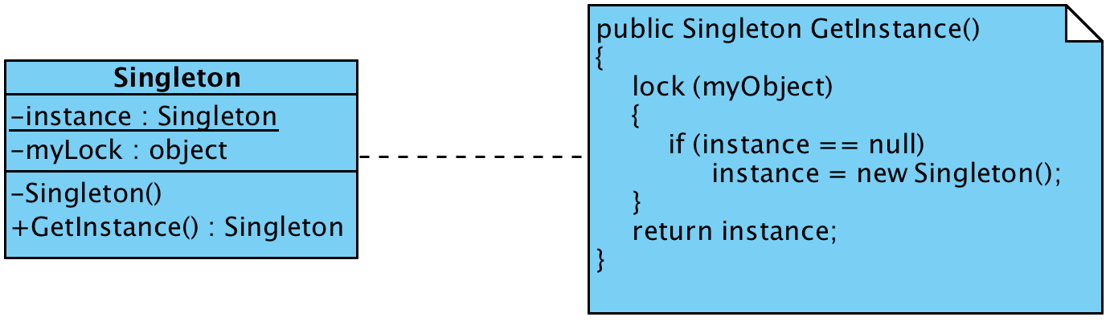
Singleton Pattern
Solution: Declare a class with a private constructor and a class-scope method or property that constructs the single instance if it does not already exist and return that instance

Slide 26
Singleton Pattern
Consequences:
Controlled access to single instance
Avoid polluting the namespace with global variables
Permits refinement of operations and representation
It allows developers to change their mind and allow variable number of instances, i.e., it’s easy to move to flyweight or object pool.
More flexible that class operations (static methods or static classes)

Slide 27
Flyweight Pattern
Intent: Support large numbers of objects which have common state information
Context: A system that needs to manage large numbers of objects of various kinds. The objects’ state information can be divided in to two parts, intrinsic and extrinsic. The intrinsic state information is same for all objects of the same kind and it is immutable. Also, the intrinsic state information of objects is relatively large.
Problem: How optimize memory and performance by sharing the intrinsic state information for all objects of the same kind.

Slide 28
Flyweight Pattern
Solution: Each product family is implemented in its own hierarchy that defined the “flyweight” perspective of the object. In other words, it defines the base class defined the operations on the product family (i.e., the interface) and the concrete classes implement the intrinsic state. The operations include the extrinsic states as parameters. Alternatively, a decorator pattern can be used to add the extrinsic states to the flyweight objects.

Slide 29
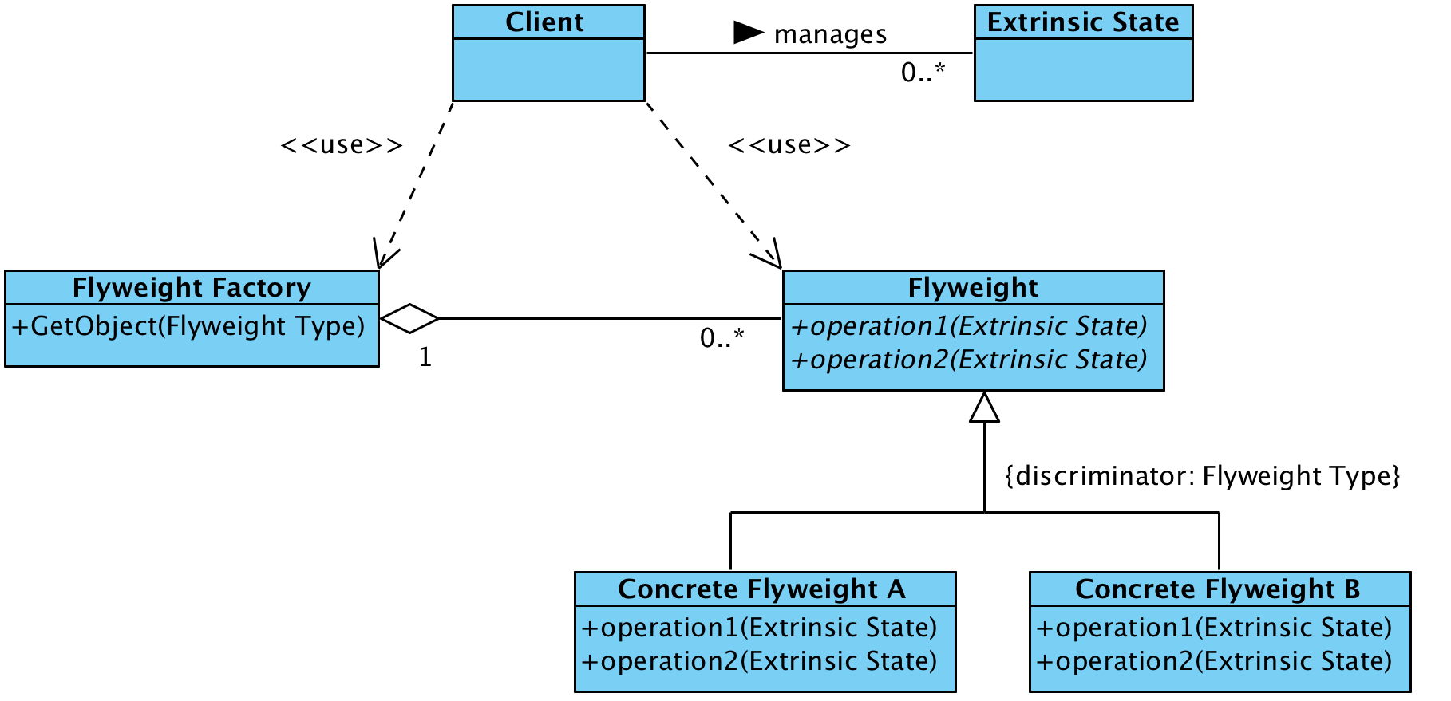
Flyweight Pattern
Client manages Extrinsic State

Slide 30
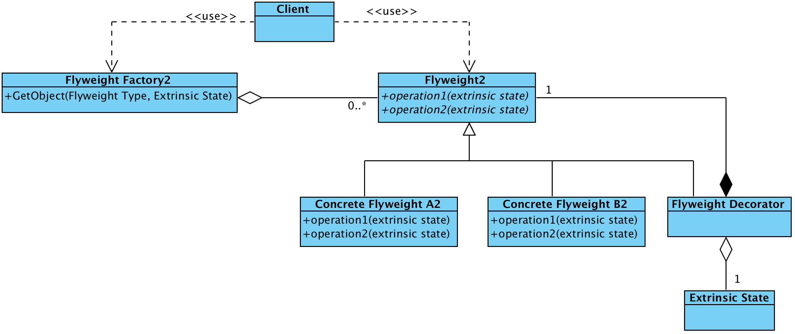
Flyweight Pattern
Flyweight Decorators manages Extrinsic State

Slide 31
Flyweight Pattern
Consequences:
Better utilization of memory / disk space
Potentially faster object instantiate
Related Patterns: Decoration, Composition

